Slide 1
Warm Up
1) In what two ways can refraction be useful?
A)
B)
2) Where have you seen lenses get used?

Slide 2
Goals
Discuss Total Internal Reflection
Discuss the Ray diagram rules for Lenses

Slide 3
Lens Ray Diagram Rules
1) Parallel – focal point
A parallel ray will get refracted through a focal point
2) Focal Point – Parallel
A ray aimed through a focal point will come out parallel
3) Center of the lens
A line through the center of the lens will NOT bend
YOU ONLY NEED TO USE 2 of THESE AT A TIME

Slide 4
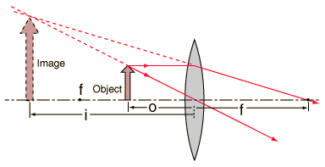
Convex Lenses (Bend in)

Slide 5
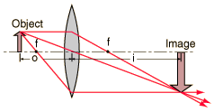
Convex Lenses

Slide 6
Practice

Slide 7
Practice

Slide 8
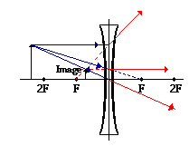
Concave lenses (Spread out)

Slide 9
Practice

Slide 10
Cool Down
1) What do you think will help you remember whether a lens is diverging or converging (when to bend light towards or away from the principle axis)?
2) Turn in Warm Up/Cool Down sheet

