Slide 1
Warm Up
1) Why do people use curved mirrors?
2) How do you draw a ray diagram for a curved mirror?

Slide 2
Goals
Discuss examples of curved mirrors
Practice Ray diagrams for curved mirrors

Slide 3
Practice
Curved Mirror Ray diagram worksheet(s)

Slide 4
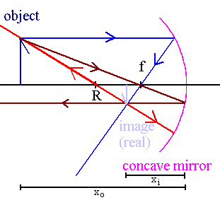
ConCAVE mirrors

Slide 5
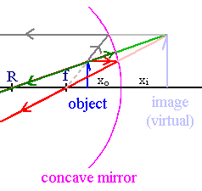
Concave Mirror Virtual Image

Slide 6
Cool Down
1) What is a Plane mirror?
2) Light hits a plane mirror at a 23 degree angle. It will be reflected through an angle of how many degrees?

